Slide 1
E-Portfolio ESP8266
WiFi - Microcontroller

Slide 2
Contents
About the ESP
Models
Setup / Programming
Communication to Arduino
Examples
Coding

Slide 3
About
WiFi – module (Full TCP/IP stack)
Can be used a a web client or server
32-Bit-Microcontroller
Cheap (~3€)
Decent range
IOT (Weather station / LED controlling / …)

Slide 4
About
SDK is open source
Runs on 3.3V logic!
C++ / Micropython / At-Commands
AT: Used to configure modems / routers
However you can also configure it using C++ / Python

Slide 5
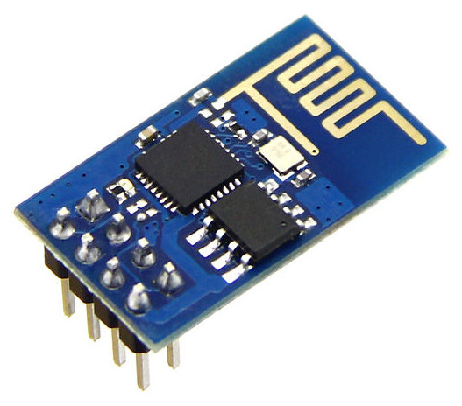
Versions
ESP Version-01
8 Pins
Flashing via. USB – UART- Converter
ESP-WROOM-02
18 Pins
Existing USB - port

Slide 6
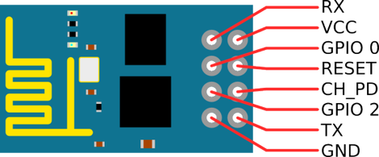
Versions
Big variety of versions, the principle stays the same
ID | Usage
RX | Serial Input
VCC | Voltage Supply
GPIO 0 | HIGH = Flashing
RESET | LOW = RESET (Pullup to high)
GPIO 2 | HIGH
CH_PD | LOW = Power Down (Chip not running)
GND | Ground
TX | Serial Output

Slide 7
Setup - Hardware
USB Cable
USB -> UART Converter
You can also use an Arduino -> Bridge RST to GND
5V to 3.3V Converter
Breadboard for connecting pins / reset button
Connect like shown in the hardware diagram

Slide 8
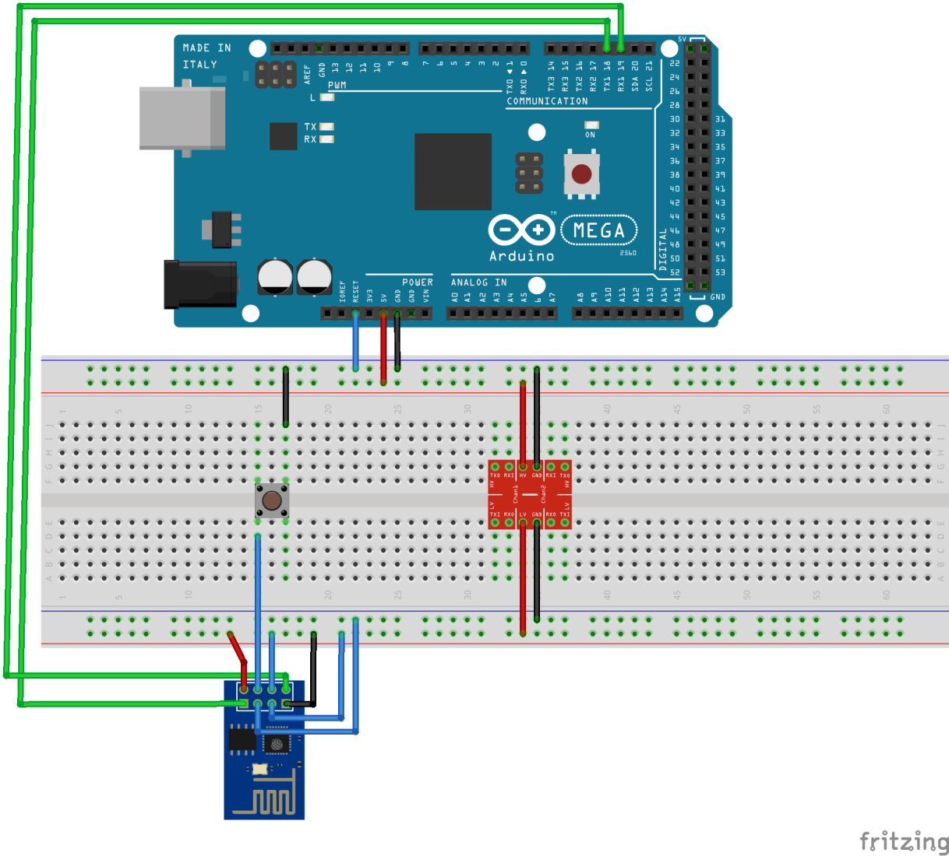
Setup - Hardwarediagram

Slide 9
Setup - Software
Many IDEs can be used, in my case Arduino IDE
Download ESP – Core for Arduino IDE
Select board from board manager
Upload

Slide 10
Programming
The ESP8266WiFi.h library includes all the necessary functions such as:
Code | Description
WiFi.begin(ssid,pass) | Connecting to network
WiFi.disconnect() | Disconnecting
WiFi.scanNetworks() | Scanning available networks
WiFiClient client | Creating client for requests
WiFiServer server(port) | Creating server

Slide 11
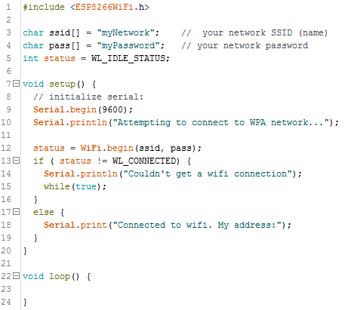
Programming – Minimal Example

Slide 12
Communication to other devices / Arduino
What to do when you need more outputs?
Connect the ESP to another microcontroller
How to communicate?
Using UART, the arduino mega e.g. supports three hardware serial conenctions
Start serial communication with the same baud rate
Set baud rate low to prevent serial buffer overflow!

Slide 13
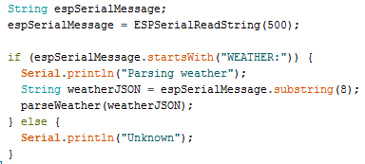
Communication to other devices / Arduino
Filter out commands by checking the beginning of the message for keywords.

Slide 14
Examples - Webclient
Connects to WiFi network
Creates get-request to api.openwathermap.org
Displays response

Slide 15
Examples - Webserver
Connects to WiFi network
Creates a response site for a get request /hello

Slide 16
Coding
Weather station
Gets current weather from an API
Sends JSON to an arduino
Arduino displays it on an LCD

Slide 17
Sources
https://create.arduino.cc/projecthub/ROBINTHOMAS/esp8266-esp-01-webserver-7248ca?ref=tag&ref_id=esp8266&offset=1
https://forum.arduino.cc/index.php?topic=462829.0
http://www.whatimade.today/esp8266-easiest-way-to-program-so-far/
https://de.wikipedia.org/wiki/AT-Befehlssatz
https://en.wikipedia.org/wiki/ESP8266
https://www.espressif.com/en/products/hardware/esp32/overview
http://stefanfrings.de/esp8266/
Images:
http://stefanfrings.de/esp8266/ESP-01.jpg
https://pradeepsinghblog.files.wordpress.com/2016/04/esp8266-5.png?w=470&h=195

